Slide 1
Lecture # 2 Legacy Projects
Engr. Naveera Sami

Slide 2
LEGACY SYSTEMS A legacy software system is an old program that continues to be used because it still meets the users’ needs, in spite of the availability of newer technology or more efficient methods of performing the task. More often than not, a legacy system includes outdated procedures or terminology, and it is very difficult for new developers to understand the system.
Organizations continue to use legacy systems because those are vital to them and the systems significantly resist modification and evolution to meet new and constantly changing business requirements.
A legacy system falls in the Phase out stage of the software evolution model of Rajlich and Bennet described earlier. Organizations in business for a long time generally possess a sizable number of legacy systems.

Slide 3

Hands up if this scene sounds familiar: You arrive at work, grab a coffee, and decide to catch up on the latest tech blogs. You start to read about how the hippest young startup in Silicon Valley is combining fashionable programming language X with exciting NoSQL datastore Y and big data tool Z to change the world, and your heart sinks as you realize that you’ll never find the time to even try any of these technologies in your own job, let alone use them to improve your product

Slide 4
Why not? Because you’re tasked with maintaining a few zillion lines of untested, undocumented, incomprehensible legacy code. This code has been in production since before you wrote your first Hello World and has seen dozens of developers come and go.
You spend half of your working day reviewing commits to make sure that they don’t cause any regressions, and the other half fighting fires when a bug inevitably slips through the cracks. And the most depressing part of it is that as time goes by, and more code is added to the increasingly fragile codebase, the problem gets worse.

Slide 5
Definition of a legacy project
First of all, I want to make sure we’re on the same page concerning what a legacy project is.
I tend to use a very broad definition, labeling as legacy any existing project that’s difficult to maintain or extend. Note that we’re talking about a project here, not just a codebase. As developers, we tend to focus on the code, but a project encompasses many other aspects, including
○ Build tools and scripts
○ Dependencies on other systems
○ The infrastructure on which the software runs
○ Project documentation
○ Methods of communication, such as between developers, or between developers and stakeholders

Slide 6

Characteristics of legacy projects
OLD
Usually a project needs to exist for a few years before it gains enough entropy to become really difficult to maintain. In that time, it will also go through a number of generations of maintainers. With each of these handoffs, knowledge about the original design of the system and the intentions of the previous maintainer is also lost.

Slide 7
Characteristics of legacy projects
LARGE
It goes without saying that the larger the project is, the more difficult it is to maintain. There is more code to understand, a larger number of existing bugs (if we assume a constant defect rate in software, more code = more bugs), and a higher probability of a new change causing a regression, because there is more existing code that it can potentially affect. The size of a project also affects decisions about how the project is maintained. Large projects are difficult and risky to replace, so they are more likely to live on and become legacy

Slide 8

Characteristics of legacy projects
INHERITED
As is implied by the common meaning of the word legacy, these projects are usually inherited from a previous developer or team. In other words, the people who originally wrote the code and those who now maintain it are not the same individuals, and they may even be separated by several intermediate generations of developers. This means that the current maintainers have no way of knowing why the code works the way it does, and they’re often forced to guess the intentions and tacit design assumptions of the people who wrote

Slide 9

Characteristics of legacy projects
POORLY DOCUMENTED
Given that the project spans multiple generations of developers, it would seem that keeping accurate and thorough documentation is essential to its long-term survival. Unfortunately, if there’s one thing that developers enjoy less than writing documentation, it’s keeping that documentation up to date. So any technical documents that do exist must invariably be taken with a pinch of salt.

Slide 10
Exceptions to the rule:
Just because a project fulfills some of the preceding criteria doesn’t necessarily mean it should be treated as a legacy project.
A perfect example of this is the Linux kernel. It’s been in development since 1991, so it’s definitely old, and it’s also large. (The exact number of lines of code is difficult to determine, as it depends on how you count them, but it’s said to be around 15 million at the time of writing.) Despite this, the Linux kernel has managed to maintain a very high level of quality. As evidence of this, in 2012 Coverity ran a static analysis scan on the kernel and found it to have a defect density of 0.66 defects/kloc, which is lower than many commercial projects of a comparable size. Coverity’s report concluded that “Linux continues to be a ‘model citizen’ open source project for good software quality.”

Slide 11
Untested, untestable code
Given that technical documentation for software projects is usually either nonexistent or unreliable, tests are often the best place to look for clues about the system’s behavior and design assumptions. A good test suite can function as the de facto documentation for a project. In fact, tests can even be more useful than documentation, because they’re more likely to be kept in sync with the actual behavior of the system. A socially responsible developer will take care to fix any tests that were broken by their change to production code. (Any developer in my team who breaks this social contract is sent straight to the firing squad!) Unfortunately, many legacy projects have almost no tests. Not only this, but the projects are usually written without testing in mind, so retroactively adding tests is extremely difficult. A code sample is worth a thousand words,

Slide 12
code sample is worth a thousand words, so let’s look at an example that illustrates this.
public class ImageResizer {
/* Where to store resized images */
public static final String CACHE_DIR = "/var/data";
/* Maximum width of resized images */
private final int maxWidth =
Integer.parseInt(System.getProperty("Resizer.maxWidth", "1000"));
/* Helper to download an image from a URL */
private final Downloader downloader = new HttpDownloader();
/* Cache in which to store resized images */
private final ImageCache cache = new FileImageCache(CACHE_DIR);
/**
* Retrieve the image at the given URL
* and resize it to the given dimensions.
*/
Untestable Code

Slide 13
public Image getImage(String url, int width, int height) {
String cacheKey = url + "_" + width + "_" + height;
// First look in the cache
Image cached = cache.get(cacheKey);
if (cached != null) {
// Cache hit
return cached;
} else {
// Cache miss. Download the image, resize it and cache the result.
byte[] original = downloader.get(url);
Image resized = resize(original, width, height);
cache.put(cacheKey, resized);
return resized;
}
}
private Image resize(byte[] original, int width, int height) {
...
}
}

Slide 14
The ImageResizer’s job is to retrieve an image from a given URL and resize it to a given height and width. It has a helper class to do the downloading and a cache to save the resized images. You’d like to write a unit test for ImageResizer so that you can verify your assumptions about how the image resizing logic works
Unfortunately, this class is difficult to test because the implementations of its dependencies (the downloader and the cache) are hardcoded. Ideally you’d like to mock these in your tests, so that you can avoid actually downloading files from the internet or storing them on the filesystem. You could provide a mock downloader that simply returns some predefined data when asked to retrieve an image from http://example.com/foo.jpg. But the implementations are fixed and you have no way of overriding them for your tests.
At least the maxWidth field is set via system property rather than being hardcoded, so you can change the value of this field and test that the image-resizing logic correctly limits the width of images. But setting system properties for a test is extremely cumbersome.
You have to:
Save any existing value of the system property.
Set the system property to the value you want.
Run the test.
Restore the system property to the value that you saved. You must make sure to do this even if the test fails or throws an exception.

Slide 15
Inflexible code
A common problem with legacy code is that implementing new features or changes to existing behavior is inordinately difficult. What seems like a minor change can involve editing code in a lot of places. To make matters worse, each one of those edits also needs to be tested, often manually. Imagine your application defines two types of users: Admins and Normal users.
Admins are allowed to do anything, whereas the actions of Normal users are restricted. The authorization checks are implemented simply as if statements, spread throughout the codebase. It’s a large and complex application, so there are a few hundred of these checks in total, each one looking like the following.

Slide 16
public void deleteWibble(Wibble wibble)
throws NotAuthorizedException {
if (!loggedInUser.isAdmin()) {
throw new NotAuthorizedException(
"Only Admins are allowed to delete wibbles");
}
...
}

Slide 17
One day you’re asked to add a new user type called Power User. These users can do more than Normal users but are not as powerful as Admins.
So for every action that Power Users are allowed to perform, you’ll have to search through the codebase, find the corresponding if statement, and update it to look like this.
public void deleteWibble(Wibble wibble)
throws NotAuthorizedException {
if (!(loggedInUser.isAdmin() || loggedInUser.isPowerUser()) {
throw new NotAuthorizedException(
"Only Admins and Power Users are allowed to delete wibbles");
}
...
}
We’ll come back to this example in chapter 4 and look at how you could refactor the application to be more amenable to change.

Slide 18
Legacy Infrastructure
Although the quality of the code is a major factor in the maintainability of any legacy project, just looking at the code doesn’t show you the whole picture.
Most software depends on an assortment of tools and infrastructure in order to run, and the quality of these tools can also have a dramatic effect on a team’s productivity. In part 3 we’ll look at ways to make improvements in this area.

Slide 19
Development environment:
Think about the last time you took an existing project and set it up on your development machine. Approximately how long did it take, from first checking the code out of version control to reaching a state where you could do the following?
○ View and edit the code in your IDE
○ Run the unit and integration tests
○ Run the application on your local machine

Slide 20
Setting up a legacy project often involves a combination of
○ Downloading, installing, and learning how to run whatever arcane build tool the project uses
○ Running the mysterious and unmaintained scripts you found in the project’s /bin folder
○ Taking a large number of manual steps, listed on an invariably out-of-date wiki page

Slide 21
Outdated dependencies:
Nearly any software project has some dependencies on third-party software. For example, if it’s a Java servlet web application, it will depend on Java.
It also needs to run inside a servlet container such as Tomcat, and may also use a web server such as Apache. Most likely, it will also use various Java libraries such as Apache Commons.
The rate at which these external dependencies change is outside of your control.

Slide 22
Outdated dependencies:
Keeping up with the latest versions of all dependencies is a constant effort, but it’s usually worthwhile. Upgrades often provide performance improvements and bug fixes, and sometimes critical security patches.
While you shouldn’t upgrade dependencies just for the sake of it, upgrading is usually a Good Thing.

Slide 23
Legacy culture:
The term legacy culture is perhaps a little contentious—nobody wants to think of themselves and their culture as legacy—but I’ve noticed that many software teams who spend too much time maintaining legacy projects share certain characteristics with respect to how they develop software and communicate among themselves.

Slide 24
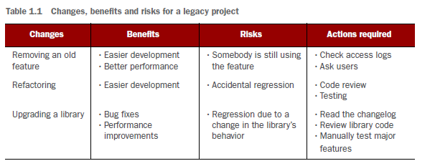

Slide 25
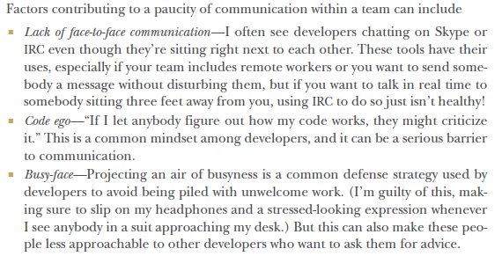

Slide 26
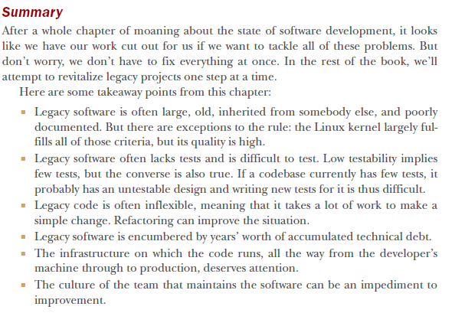

Slide 27
